Slide 1
Data Validation Approaches
Pravin Y Pawar
Largely Adapted from
“Data Validation in Machine Learning is imperative, not optional”

Slide 2
Data validation
Definition
Data Validation
means checking the accuracy and quality of source data before training a new model version
ensures that anomalies that are infrequent or manifested in incremental data are not silently ignored
focuses on checking that the statistics of the new data are as expected (e.g. feature distribution,
number of categories, etc)
Examples of such validations in the machine learning pipeline:
Are there any anomalies or data errors in the incremental data?
Are there any assumptions on data that are taken during model training and are getting violated during serving?
Are there significant differences between training and serving data?
Are there differences between successive data that are getting added into training data?
Output from the data validation steps should be informative enough for a data engineer to take action
needs to have high precision as too many false alarms will easily be lost credibility

Slide 3
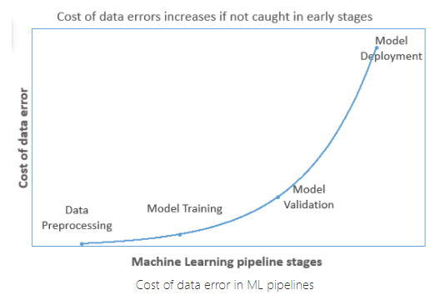
Data validation(2)
Requirement
“garbage in garbage out”
Machine learning models are vulnerable to poor data quality
In Production
model gets re-trained with a fresh set of incremental data added periodically
(as frequent as daily)
updated model is pushed to the serving layer
deployed model makes predictions with new incoming data while serving
and the same data is added with actual labels and used for retraining
ensures that the newly generated model adapts to the changes in data
characteristics
New incoming data in the serving layer can change due to various reasons
with time, the erroneous ingested data​​​​​​​ will become part of the training data,
which will start degrading the model accuracy
Catching the data errors at an early stage is very important
will reduce the cost of data error which is bound to increase as the error
propagates further in the pipeline

Slide 4
Challenges with the data validation
Creating data validation rules for a dataset with few columns does sound simple
when the number of columns in datasets increases, it becomes a humongous task
Tracking and comparing metrics from the historical datasets to find anomalies in historical trends
for each column needs a good amount of recurring time from a data scientist
Today applications are expected to run 24-by-7 and in such scenarios, data validation needs to be automated
data validation component should be smart enough to refresh validation rules

Slide 5
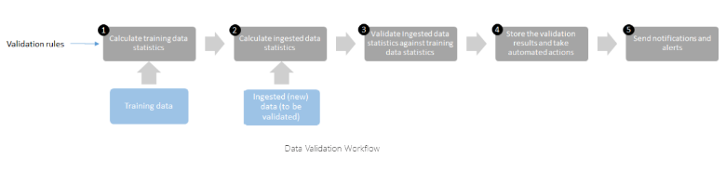
Working of data validation component
Data validation component serves as a guard post of the ML application
does not let bad quality data in
keeps a check on each and every new data entry that is going to add to the training data
​​
Steps
Calculate the statistics from the training data against a set of rules
Calculate the statistics of the ingested data that has to be validated
Compare the statistics of the validation data with the statistics from the training data
Store the validation results and takes automated actions like removing the row, capping, or flooring the values
Sending the notification and alerts for approval​​​​​​​

Slide 6
Unit-test approach by Amazon Research
Deequ
In software engineering, engineers write unit tests to test their code
Similarly, unit tests should also be defined to test the incoming data
AWS Deeque framework follows the below principles
Declare constraints:
User defines how their data should look like
by declaring checks on their data by composing constraints on various columns
Compute metrics
Based on the declared constraint, translate them to measurable metrics
metrics can be computed and compared between the data in hand and the incremental data
Analyze and report
Based on the collected metrics over time, predict if the metric on the incremental data is an anomaly or not
As a rule, the user can have the system issue “a warning” if the new metric is more than three standard
deviations away from the previous mean or throw “an error” if it is more than four standard deviations away.
Basis the analysis, report the constraints that fail including the value(s) that made the constraint fail

Slide 7
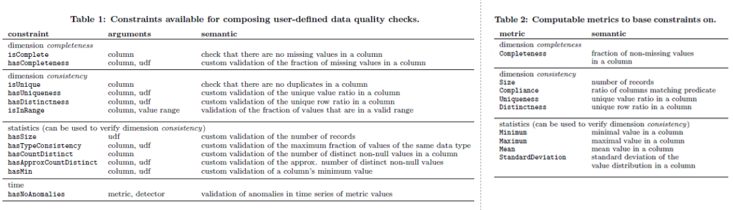
Unit-test approach by Amazon Research (2)
Deeque - Constraints

Slide 8
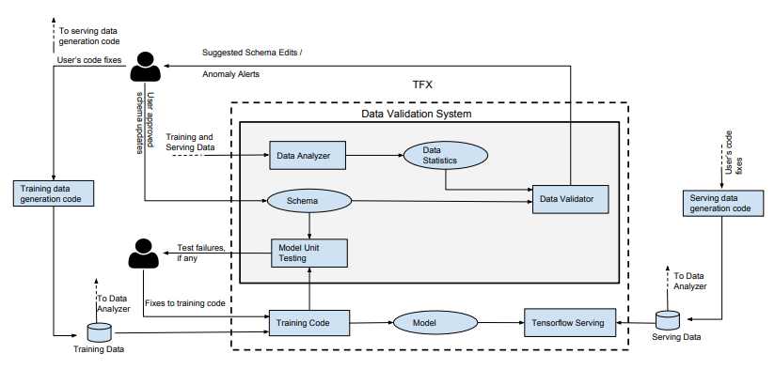
Data schema approach for data validation by Google Research
Tensorflow data validation
Google Research has come up with a very similar technique
adopted “battle-tested” principles from the data
management system and customized it for ML
first codifies the expectation from correct data and then
using these expected statistics along with user-defined
validation schema performs data validation
Components
Data Analyzer
computes a predefined set of data statistics required to define data
Data Validator
checks for properties of data as specified through a schema
schema is a precursor for a data validator to perform
schema list out all the constraints on the features for basic checks
and ML-related checks
Model Unit Tester
checks for errors in training code using synthetic data generated
through the schema

Slide 9
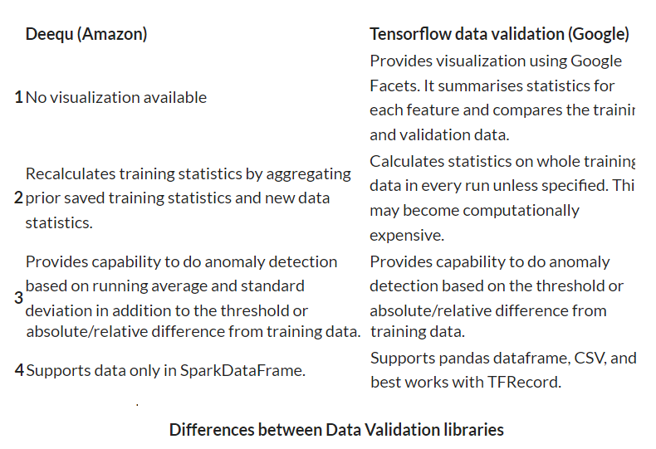
Differences between Deequ (Amazon) Tensorflow data validation (Google)

Slide 10
Thank You!
References
S. Schelter, D. Lange, P. Schmidt, M. Celikel, F. Viessmann and A. Grafberger, “Automating Large-Scale Data Quality Verification” in Proceedings of the VLDB endowment, volume 11, Issue 12: 1781-1794, 2018.
E. Breck, M. Zinkevich, N. Polyzotis, S. Whang and S. Roy, “Data validation for machine learning”, in Proceedings of the 2nd SysML Conference, Palo Alto, CA, USA, 2019
In our next session:

